Slide 1
Summary of Chronic Kidney Disease model using System Dynamics
February 2025

Slide 2
Background
Model structure
Initialising, calibrating and validating the model
Reflections & next steps

Slide 3
Background

Slide 4





Background
Midlands Renal Operational Delivery Network (MRODN) -
what will future demand for renal services look like?
changing demographics/ageing population
interventions
new medications
changing balance of KRT modalities and increase in live kidney transplants

Slide 5
Workstreams & project working
CKD SD model
KRT DES model (using incidence to KRT from SD model)
Evidence mapping
Patient Experience
Participative approach
workshops with stakeholders

Slide 6
Chronic Kidney Disease (CKD)
Progressive disease, no symptoms in early stages
Staged, from 1-5: defined by eGFR score and/or ACR result
Clinical diagnosis at stage 3 or higher – stage 5 is kidney failure and likely to lead to a need for Kidney Replacement Therapy (KRT) – dialysis and/or transplant
Most people with CKD are stable in stage 3, managed in Primary Care.
A large proportion of people with CKD are undiagnosed (over 50%)

Slide 7
How will the SD model be useful?
Help illustrate changes with demand over time and its impact on capacity
Element of the model are adjustable, so it will support decision makers to infer information about the likely effect of different interventions or allocation of resources.
For example, what is the likely impact on the number requiring KRT when improving primary care prevention, improved diagnosis, increase use of medication
Support changes to primary care identification and prescribing including the factors that impact on this and the support /interventions needed
Support future planning for KRT

Slide 8
Model Structure

Slide 9
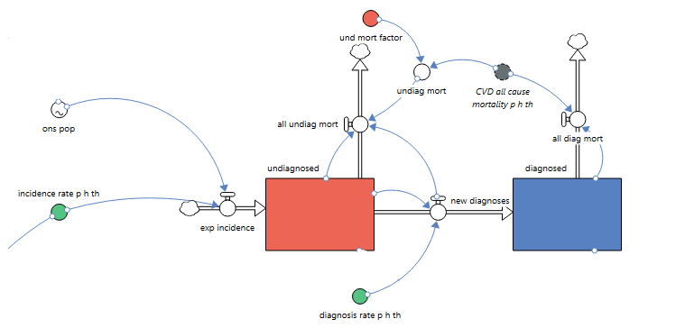
Model structure – top level

Slide 10
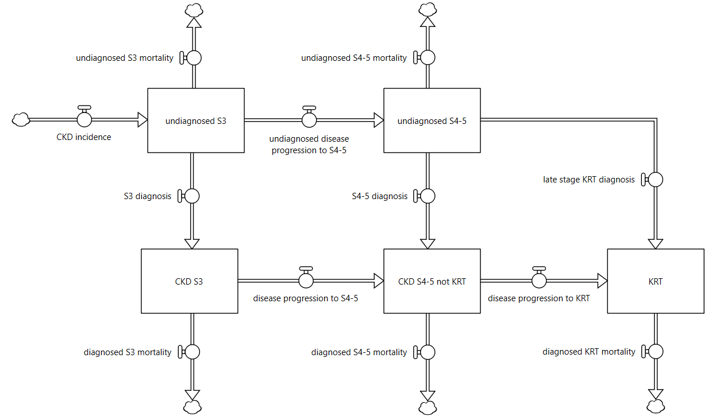
Model structure - detail
Mortality occurs at each stage and diagnosis state – scale factor applied to adjust from ‘CVD all cause mortality’ rate
For some, the disease worsens to stage 4/5 whilst still undiagnosed
Incidence rate per hundred thousand
ONS population projection
People develop CKD stage 3; initially it is undiagnosed
A very small number have a late referral to Kidney centre.
Most diagnosis occurs at stage 3
Diagnosis and management can slow the progression from stage 3 to stage 4/5
The disease can continue to worsen, leading to kidney failure for some people, requiring KRT.

Slide 11
Model structure - interventions
It is likely that a number of people who are not diagnosed CKD are prescribed SGLT2 inhibitors due to the risk factors/co-morbidities, thus also reducing progression and mortality in the undiagnosed
Primary prevention strategies can reduce the number of new cases of CKD
Increased diagnosis moves people out of the undiagnosed states into diagnosed states.
There is interest in understanding the effect that different interventions can have on the CKD population. These can be explored in the simulator.
Baseline scenario is status quo.
SGLT2 inhibitors slow the progression through the stages, and reduce the mortality at each stage.

Slide 12
Initialisation, Calibration & Validation

Slide 13
Potential Data Sources
Data is needed to:
initialise the model (set the stock levels at the start of the simulation)
update the annual number of new cases, accounting for changes in population projections
Validate the model outputs against known historical data
Source | Detail
Office for National Statistics | Population estimates and projections
CVD Prevent | Indicator: CVDP001CKD
CVD Prevent | All cause CVD mortality
UK Renal Registry | Incidence and prevalence to KRT
Inside CKD¹ | Prevalence rates and proportion diagnosed, using baseline 2022 data for the Inside CKD model
Health Survey for England, 2016 & 2022 | Combined prevalence, by stage and age (table 6)
1.Projecting the clinical burden of chronic kidney disease at the patient level (Inside CKD): a microsimulation modelling study
Chertow, Glenn M. et al., eClinicalMedicine, Volume 72, 102614

Slide 14
Initialising and calibrating the model
Calculating prevalence rates – Inside CKD
Rate per 100 000 | 3a | 3b | 4 | 5
overall | 5675 | 1961 | 365 | 48
diagnosed | 2086 | 776 | 267 | 48
undiagnosed | 3589 | 1184 | 98 | 0
Reported
Rate per 100 000 | S3 | S4/5 |  | S3 as % of total state
overall | 7636 | 413 |  | 94.9%
diagnosed | 2862 | 315 |  | 90.1%
undiagnosed | 4773 | 98 |  | 98.0%
Diagnosed as % of total | 37.5% | 76.3%
As used in model
CVD Prevent

Slide 15
Initialising and calibrating the model
Deriving stock levels (counts of prevalence by stage and diagnosis state)
Diagnosed
CVD Prevent: counts of diagnosed (18+)
1000
Stages 3-5
90.1%
9.9%
Rate per 100 000 | S3 | S4/5 |  | S3 as % of total state
overall | 7636 | 413 |  | 94.9%
diagnosed | 2862 | 315 |  | 90.1%
undiagnosed | 4773 | 98 |  | 98.0%
Diagnosed as % of total | 37.5% | 76.3%

Slide 16
Initialising and calibrating the model
Deriving stock levels (counts of prevalence by stage and diagnosis state)
Diagnosed
CVD Prevent: counts of diagnosed (18+)
Stages 3-5
1000
Stage 3
Stages 4/5
Inside CKD rates: % split by stage
Diagnosed
901
99
Rate per 100 000 | S3 | S4/5 |  | S3 as % of total state
overall | 7636 | 413 |  | 94.9%
diagnosed | 2862 | 315 |  | 90.1%
undiagnosed | 4773 | 98 |  | 98.0%
Diagnosed as % of total | 37.5% | 76.3%
23.7%
62.5%
76.3%

Slide 17
Initialising and calibrating the model
Deriving stock levels (counts of prevalence by stage and diagnosis state)
Diagnosed
CVD Prevent: counts of diagnosed (18+)
Stages 3-5
1000
Stage 3
Stages 4/5
Inside CKD rates: % split by stage
Diagnosed
901
99
Stage 3
Stages 4/5
Inside CKD rates: % split by diagnosed/undiagnosed
Diagnosed
901 is 37.5% of all stage 3
99 is 76.3% of S4/5
Undiagnosed
1502
31
Rate per 100 000 | S3 | S4/5 |  | S3 as % of total state
overall | 7636 | 413 |  | 94.9%
diagnosed | 2862 | 315 |  | 90.1%
undiagnosed | 4773 | 98 |  | 98.0%
Diagnosed as % of total | 37.5% | 76.3%
Stages 4/5

Slide 18
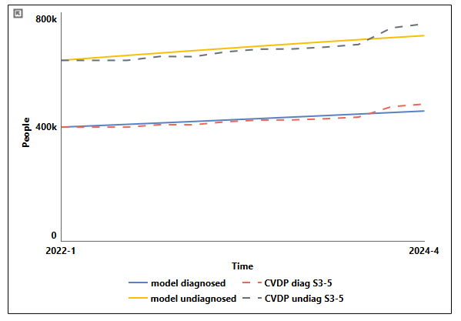
Calibration – determining incidence rate
Calibrate Incidence rate & Diagnosis rate to match CVD Prevent prevalence counts

Slide 19
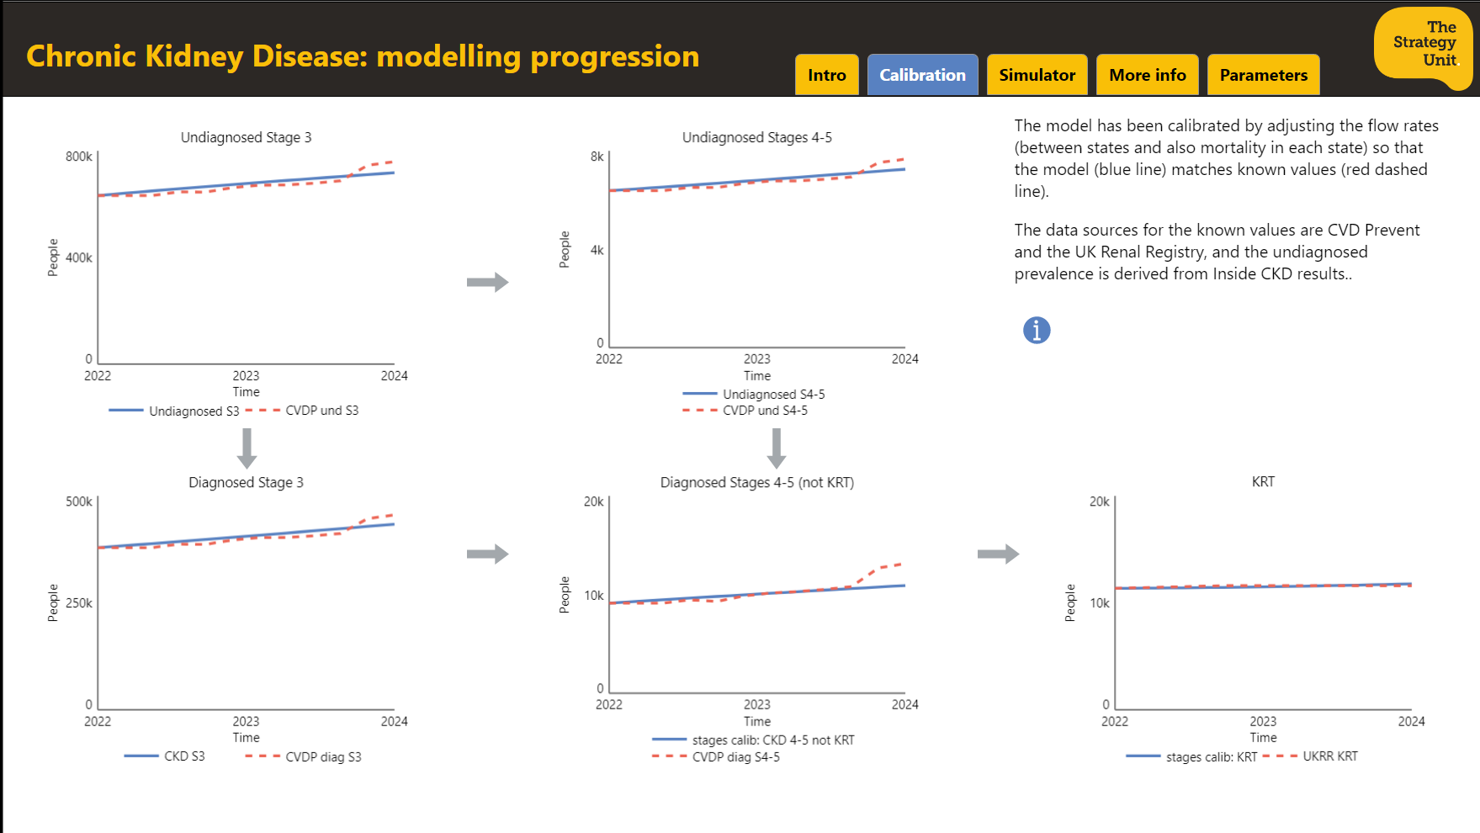
Calibration
10 known data points
Use optimisation to calibrate flow rates so that modelled stock levels fit the known values
(Also calibrate to fit high-level diagnosis rate, and all-cause CVD mortality in diagnosed stocks)

Slide 20
Validation
What does it mean? Pro-active in defining our understanding with the model-building group.
• Is the model an accurate representation of the real system?
• During the historical period, does the system behave like real-life?
• Are we sure our assumptions are reasonable?
• Can we trust the model results?

Slide 21
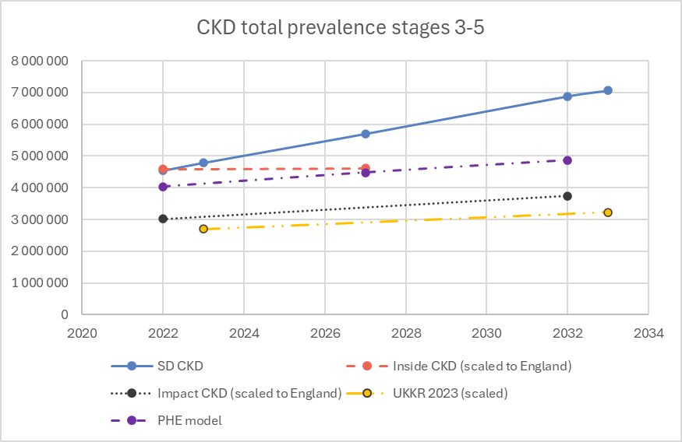
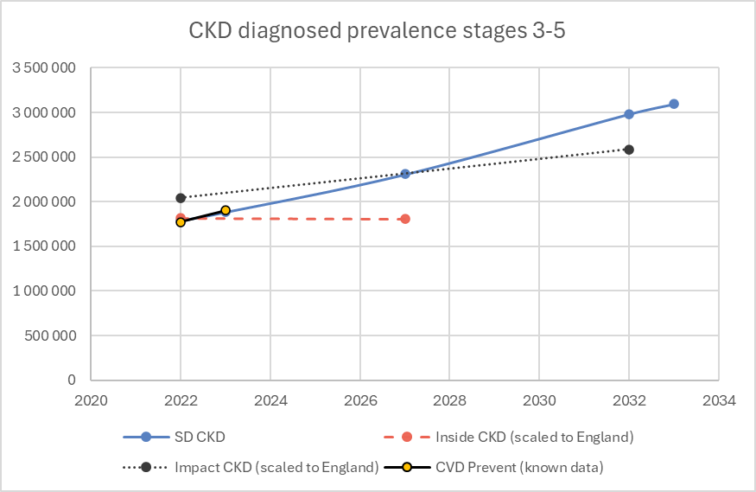
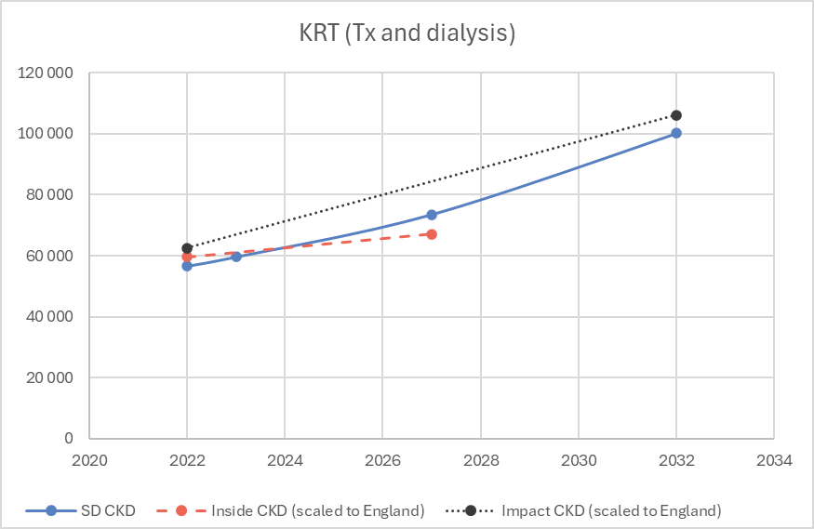
Validation – quantitative comparisons
Other models: Inside CKD (2022 – 2027), IMPACT CKD (2022 – 2032), UK Kidney Research (2023 – 2033), PHE (2014 – 2032)
Waiting for a publication which uses OpenSafely with HES/SUS+ and has up-to-date prevalence and transition rates – by age, stage, ethnicity
 | Model value | Comp value | Comparative Source
S3 as % of S3-5 (total prevalence) | 94.9% | 95.7% | HSE 2022

Slide 22
Assumptions & Limitations
Flow rates, per hundred thousand of the upstream population, are fixed throughout the simulation period.
Intervention effects are applied equally across the relevant states/stages.
The overall reduction in progression and mortality with use of SGLT2 inhibitors is a weighted average of the effects on people with and without Type 2 Diabetes¹, and assumes 30% of those with CKD also have T2D².
Mortality at each stage/state is based on the ‘all-cause mortality rate’ of CVD Prevent. A scale factor is applied at each stage/state, the values of which are deemed either by expert judgment or by in-model calibration.
A system dynamics model does not produce accurate forecasts or predictions but gives a more general view of how the system behaves under different conditions, and how this compares to the baseline scenario.
¹ https://www.thelancet.com/journals/lancet/article/PIIS0140-6736(22)02074-8/fulltext
² https://www.nature.com/articles/s41598-020-63443-4

